Slide 1


Real Estate Residential Database
Group 9
Bhavin Darji
Mohammed Rahman
Marina Lukyanchenko
Sandy Ramos
Soohun Han

Slide 2
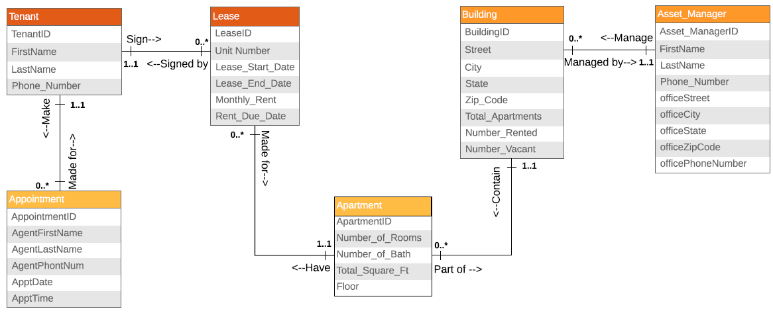
E-R Model

Slide 3
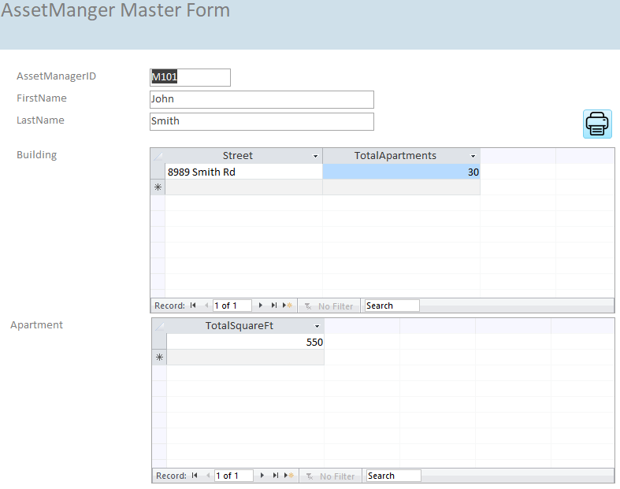
Form

